Slide 1
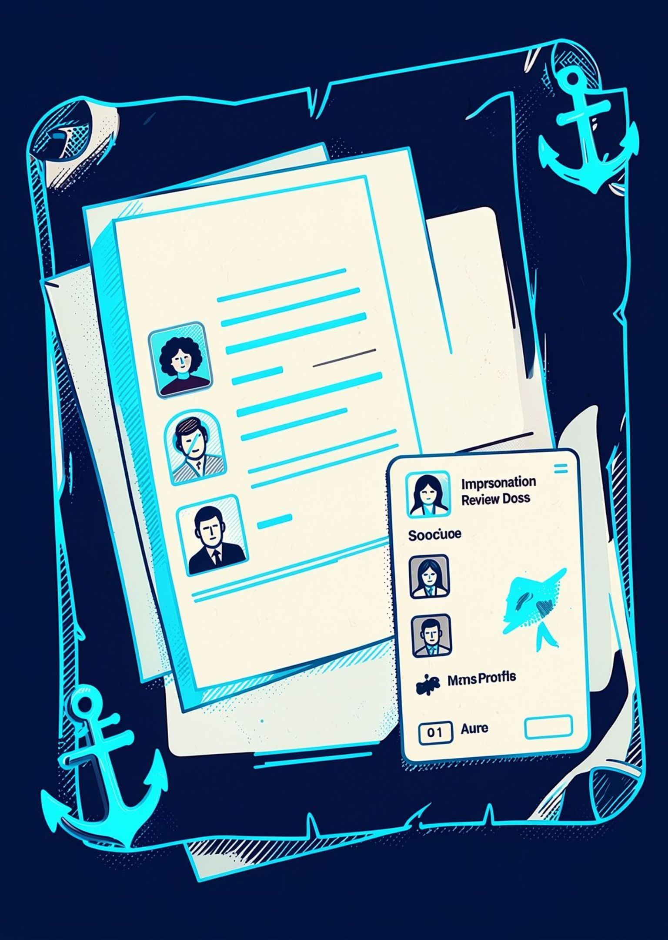





DIGITAL RISK PROTECTION
Catch impersonation
before trust breaks.
Catch social and app-store impersonation before customers trust the wrong identity.
Prevent Identity Theft
Secure Your Data
Build Trust
Safer Together
ther

Slide 2
The copy looks right.
The trust is wrong.
Each false touchpoint can mislead customers, or damage brand trust , and delay response !
CUSTOMER RISK
Customers meet the fake brand touchpoints first.
RESPONSE WINDOW
Delayed detection gives impersonators more time to act.

Slide 3

From identity to evidence
A review path built for traceable decisions.
01
02
03
04
Establish Brand Identity
Monitor Social Platforms
Scan App Stores
Verify & Prioritize Threats
Identify potentially misleading apps.
Define official brand names, domains and proflies.
Look for suspicious accounts and impersonation.
Review evidence and rank suspicious findings.
Every signal becomes reviewable evidence—not just an alert.

Slide 4





Every flag leaves a trail
Sources
Social pages, app listings.
Signals
Identity, similarity, provenance.
Memory
Findings and review state.
First filter
Official assets are excluded first.

Slide 5
"Similarity starts the review—not the verdict"
FLAGGED
NOT FLAGGED/LOWER RISK
Copied brand name
Copied logo or visual identity
Verified Official profile
Unrelated brand with no meaningful match
'Similarities raises the signal. Evidence determines the response'.

Slide 6

EVIDENCE COMPARISON
[SCREENSHOT]
Same silhouette.
Different signature.
Working app comparison
OFFICIAL
SUSPECT
Pehchaan
@pehchaan
Pehehaan
@pehchaan_official
Character diff: copied mark, altered spelling, added handle suffix.
Character differences make resemblance reviewable evidence.

Slide 7
Our fixtures make the claim testable
Detection performance on curated test sets
Metric | Value | Fixture set
Precision | Pending validation | [FIXTURE COUNT]
Recall | Pending validation | [FIXTURE COUNT]
Placeholders remain until the fixture run is verified.

Slide 8




Protect the investigator, too
Minimise
DPDP-aligned minimisation.
Guard
SSRF guards, CSP, rate limits.
Retain
Store findings, not everything seen.
Review safely. Retain deliberately.

Slide 9
Good detection gets better in public
NEXT
Expand fixtures, tune thresholds, ship review actions.
LIMITS
Coverage, fixture breadth, reviewer time.

Slide 10

When fakes appear, Pehchaan is here.
Pehchaan · digital identity, made reviewable.

